Slide 1



PLACEMENT CELL Activities for Academic year 2025 - 2026
Training and Placement Coordinator - M. Rajini
Training and placement Member - S.H. Sharooq
Training and placement Member - N. Radhika

Slide 2
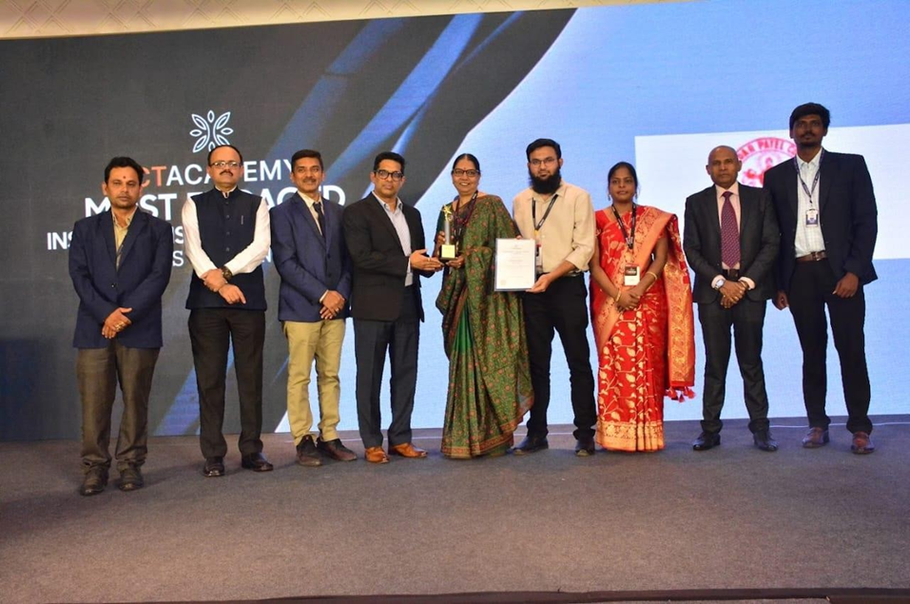
ACHIEVEMENTS
ICT Bridge Conference 2025:
Organized by ICT Academy, focusing on AI skills and industry readiness on 14th November 2025
Highlights: Presence of Dr. Palanivel Thiaga Rajan, IT Minister of Tamil Nadu, and leading companies.
Industry Support: Companies, in collaboration with ICT Academy, provide training in emerging technologies.
Achievement: Sardar Patel College received Best Supportive & Appreciation Award. And Mrs. M. Rajini honored as Best Placement Coordinator among partner colleges coordinators of ICT ACADEMY.

Slide 3
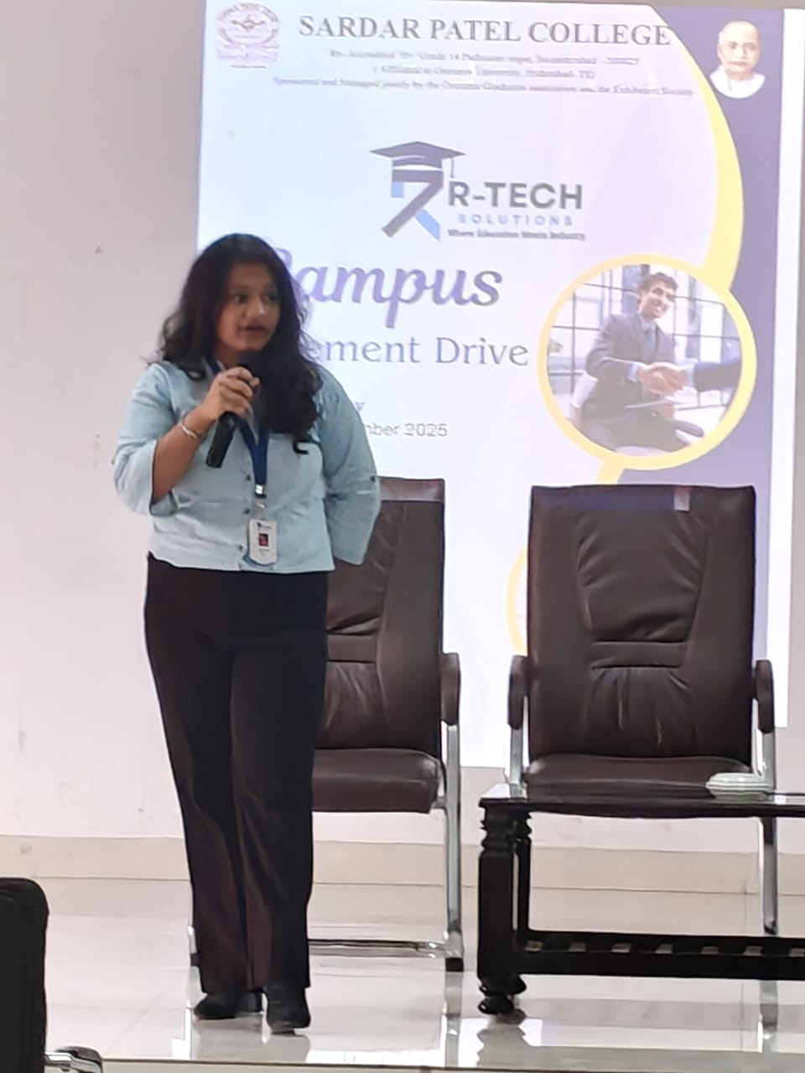
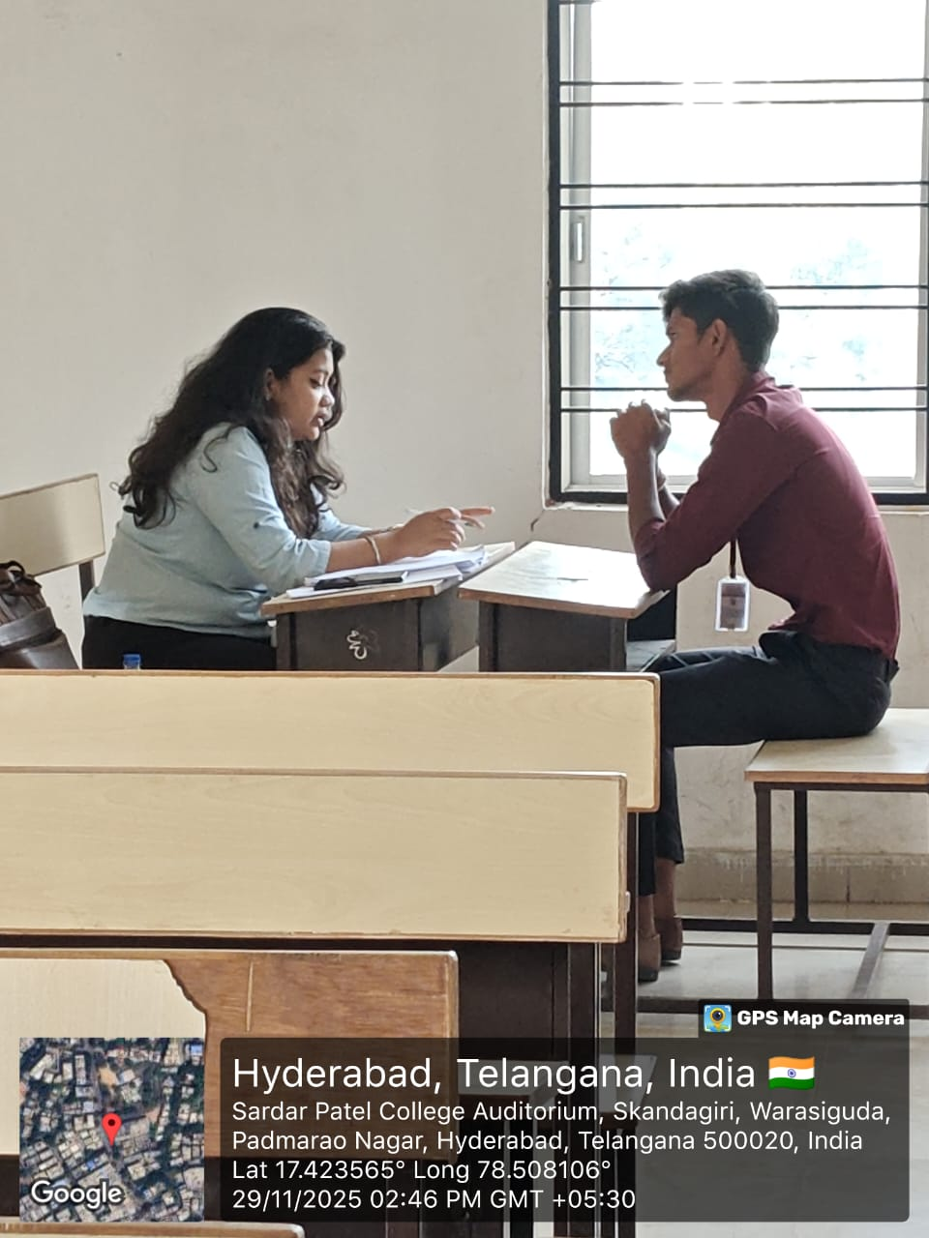
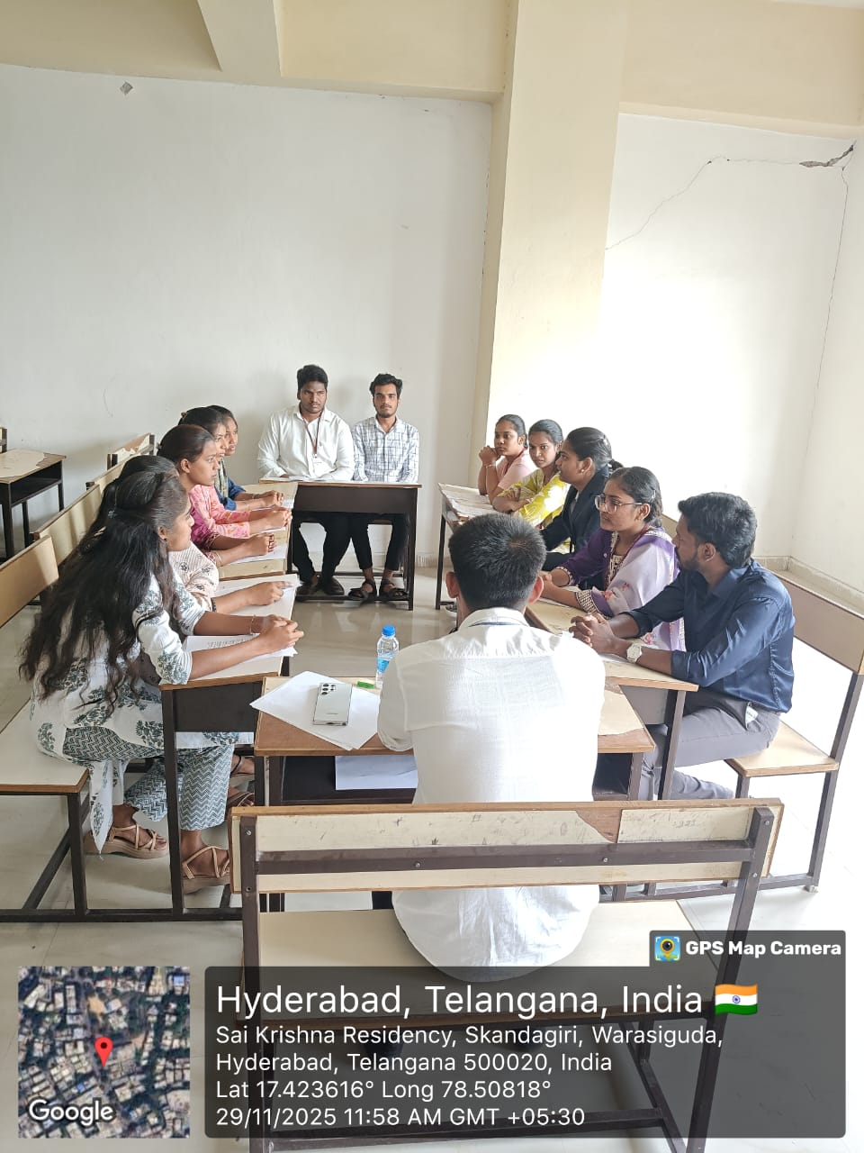
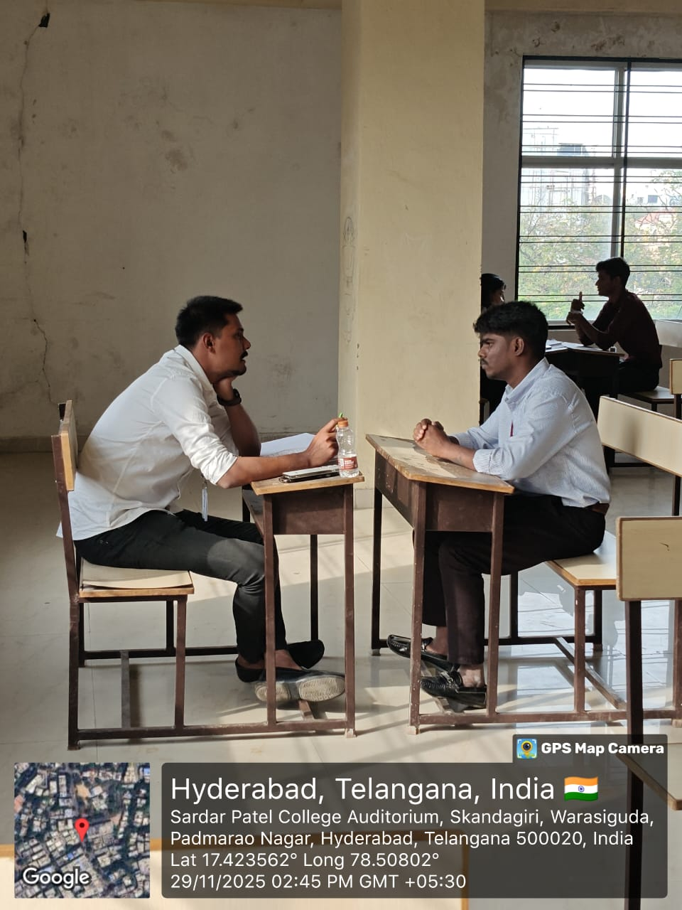
INRENSHIPS
Kindersports: 11 students are currently undertaking internships, each receiving a stipend of Rs. 12,000 per month.
Location: Hyderabad
Role: Business Development Executive
R Tech Solutions:
35 out of 85 students who attended the interview
were selected for internships, with a
stipend of Rs. 12,000 per month.
Location: Hyderabad
Role: Business Development Executive
Internspot:
8 out of 50 students who participated in the interview process were selected, with a stipend of Rs. 9,000 per month.
Location: Hyderabad
Role: Inside Sales Strategist/
HR-Intern/Digital Marketing Intern

Slide 4
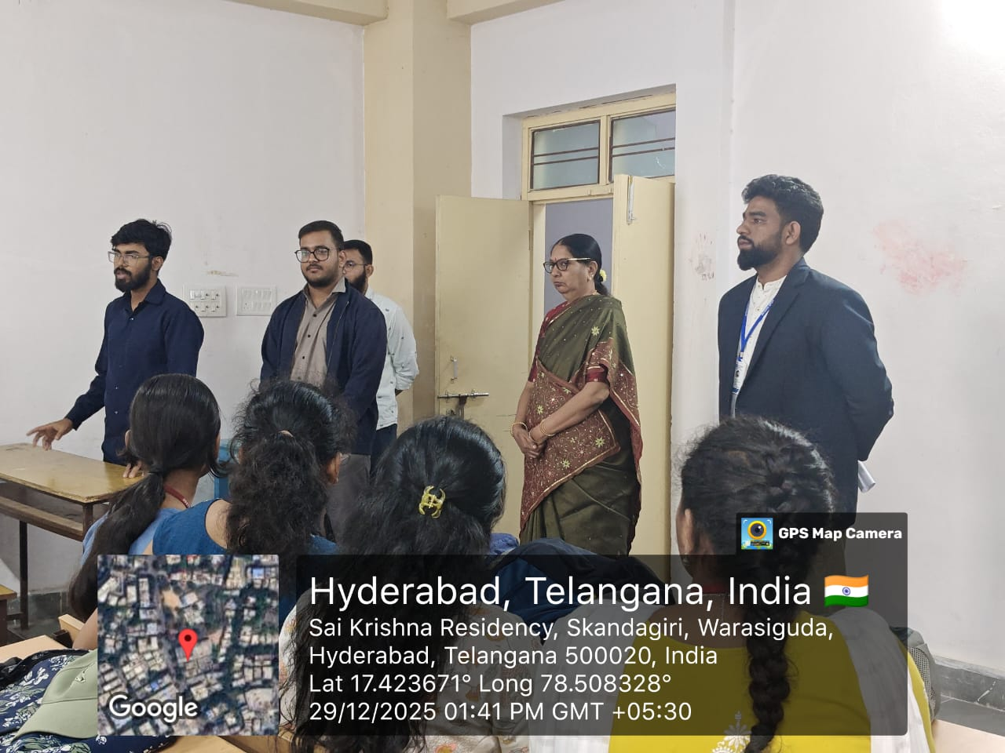
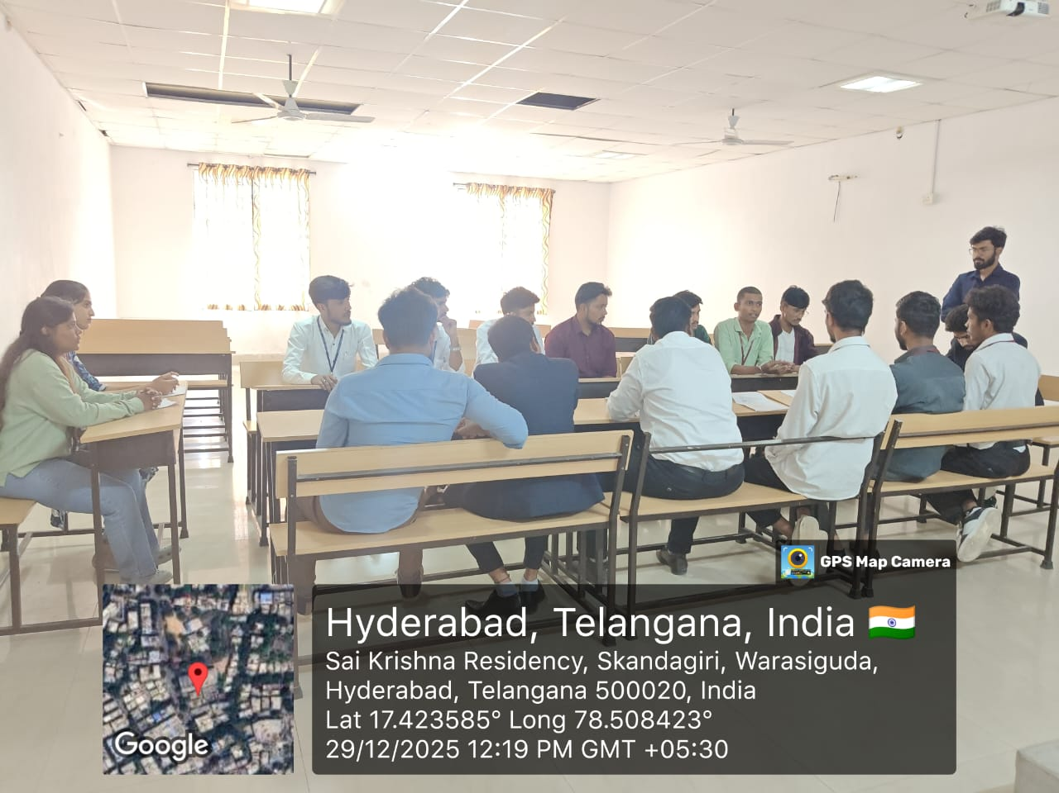
TaxProze E-File System: 3 out of 10 students who underwent the selection process were successfully placed as interns, with a stipend of Rs. 12,000 per month.
Location: Karmanghat,Hyderabad
Role: US-Tax Associate
Accenture:
6 out of 10 students who participated in the selection process successfully advanced to the final HR round.
Location: Hyderabad
Role: Sourcing and Procurement/Content Writer
Himalaya Wellness
6 students from MBA who participated in the selection process successfully advanced to the final round.
Location: Hyderabad
Role: Sales Executive

Slide 5
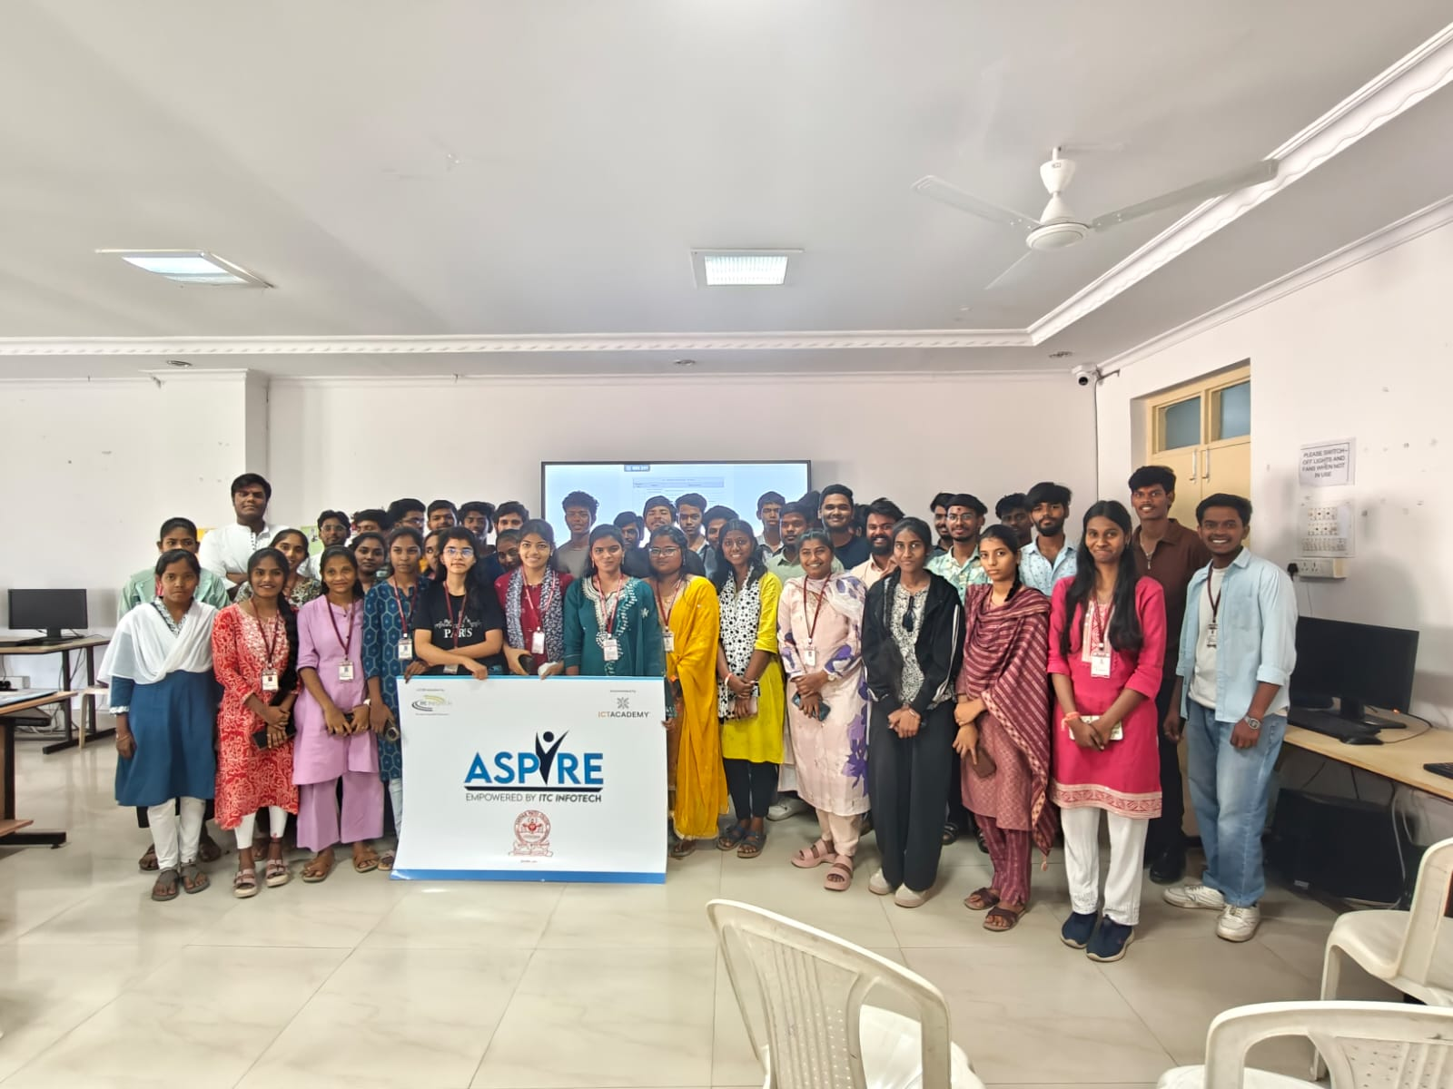
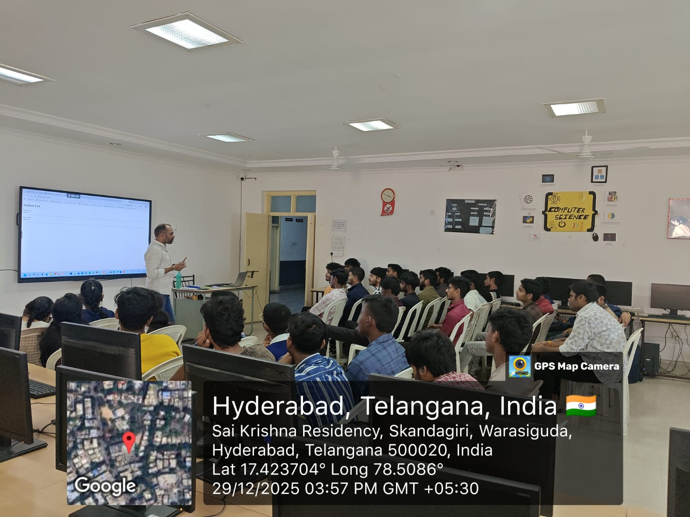
Training Programs
1. Java and Python Training Program ICT Academy conducted industry-aligned training programs for final-year and second-year students, focusing on Java Backend and Python Development to enhance technical skills and career readiness by Industrial Experts.
Enrollment: 60 students in Java and 52 students in Python Development from B.Sc(CS/DS) and B.Com(CA) courses has Enrolled.
Training Duration: Training programs were conducted for 135 hours over 45 days with hands-on learning and practical exposure Certification Achievement Outcome & Impact: Enhanced students’ technical skills and improved employability.

Slide 6
2. Premier Banker Training Program by ICT: ICT Academy is currently conducting the Premier Banker Certification Course of 100 hours over 15 days for B.Com Final Year enrolled (54) students .
Objective: To develop banking knowledge and industry-relevant skills.
Course Content: Includes banking operations, financial services, and professional skills by Y. V Rao, Retd. AGM of IDFC Bank.
Training Status: The training is ongoing with active student participation.

Slide 7
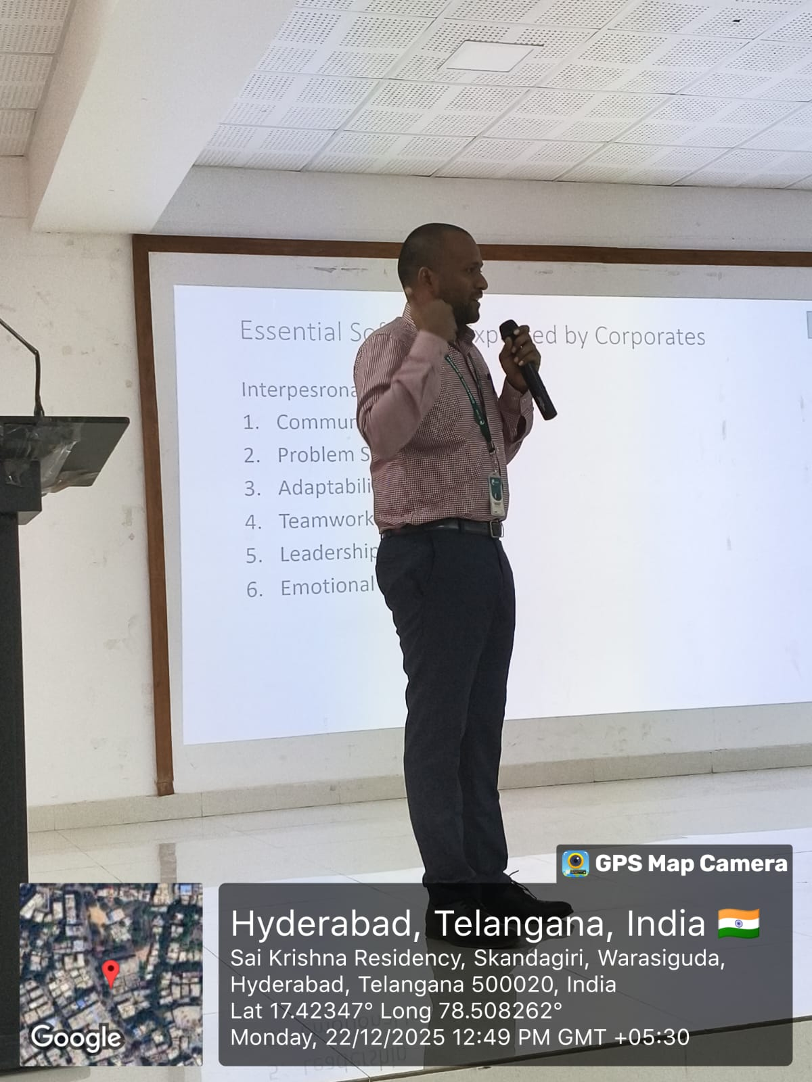
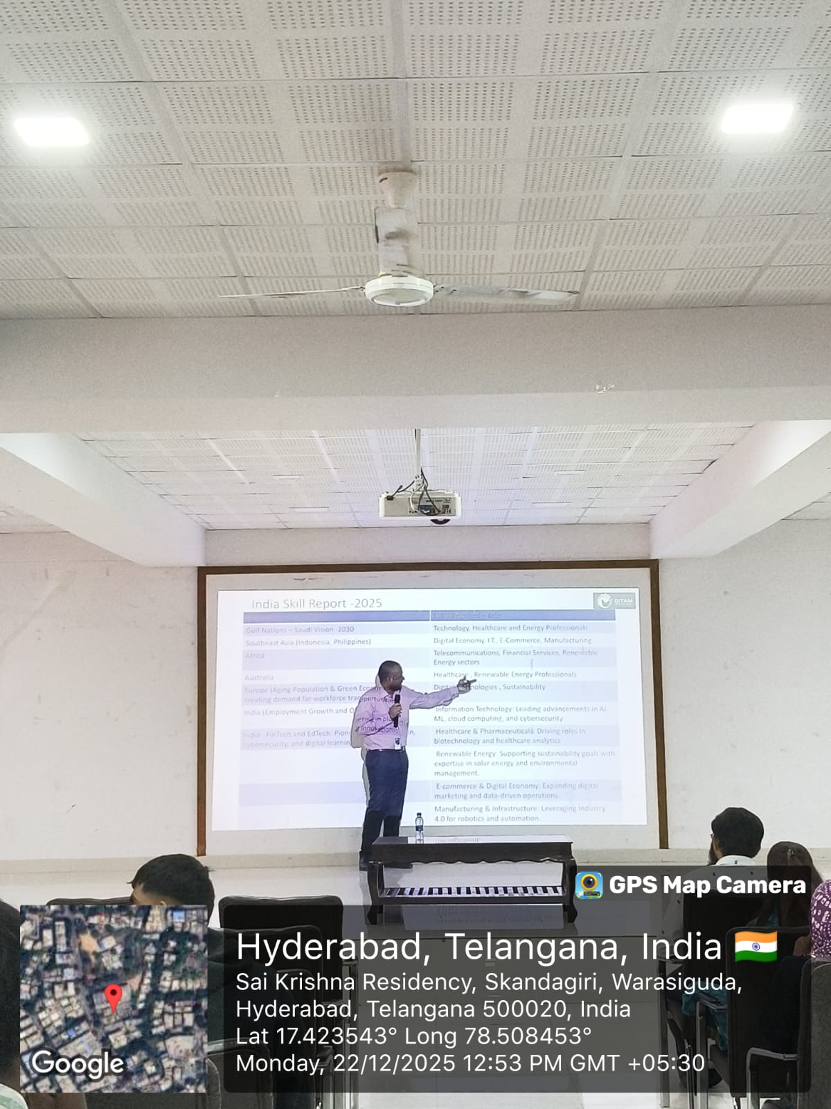
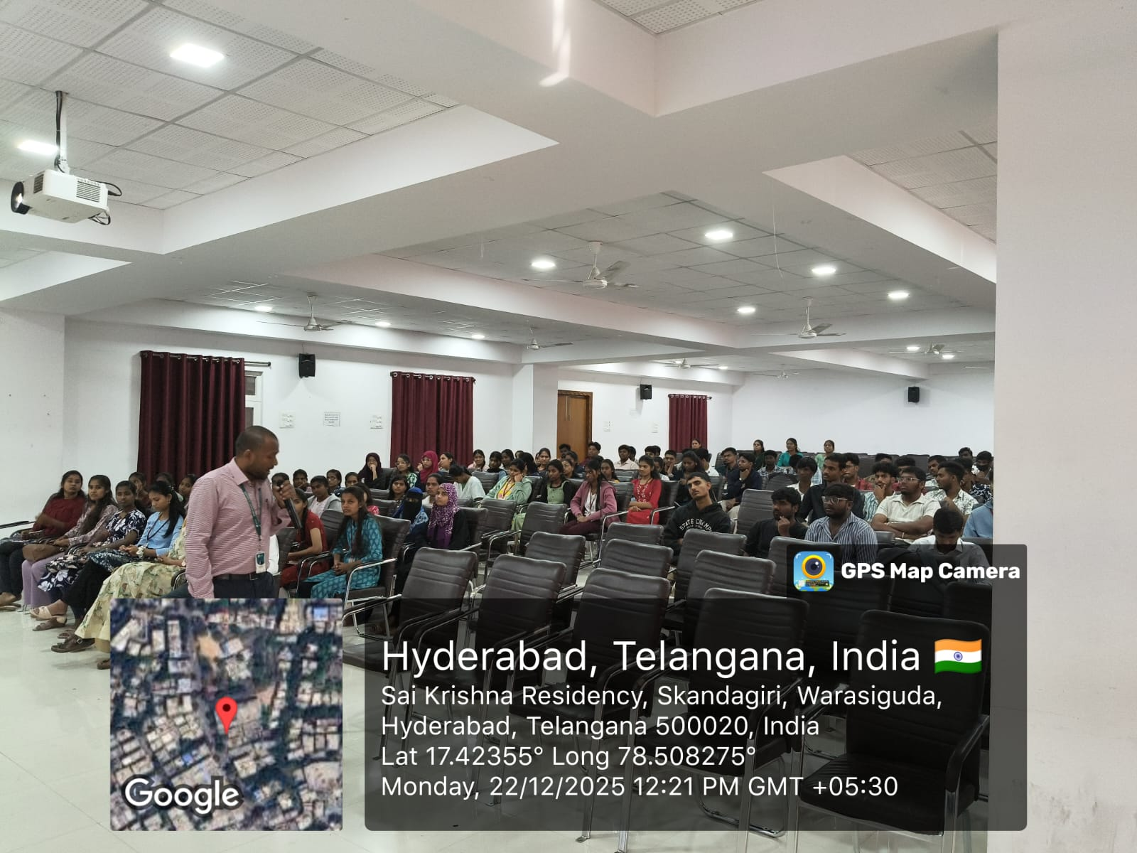
Career Guidance Program
A Career guidance program was conducted for final-year students by GITAM University.
Objective: To provide insights into career opportunities, higher education options, and industry expectations.
Key Highlights: Sessions covered career planning, resume building, interview preparation, and skill development.
Student Participation: Final-year students actively participated and engaged in interactive discussions.
Outcome: The program enhanced students’ awareness and preparedness for career opportunities and future growth.

Slide 8
List of MoUs
Signed MoUs:
UNLOX
Kindersports
TASK (Membership)
ICT Academy (Membership)
Internspot
MAPPLY Education Pvt. Ltd.
Manna Biotech
Magic Bus
Sambhav Foundation
Student Support:
Training & Skill Development
Resume Building & Profile Enhancement
Mock Interview Preparation
Internship & Placement Assistance

